Slide 1
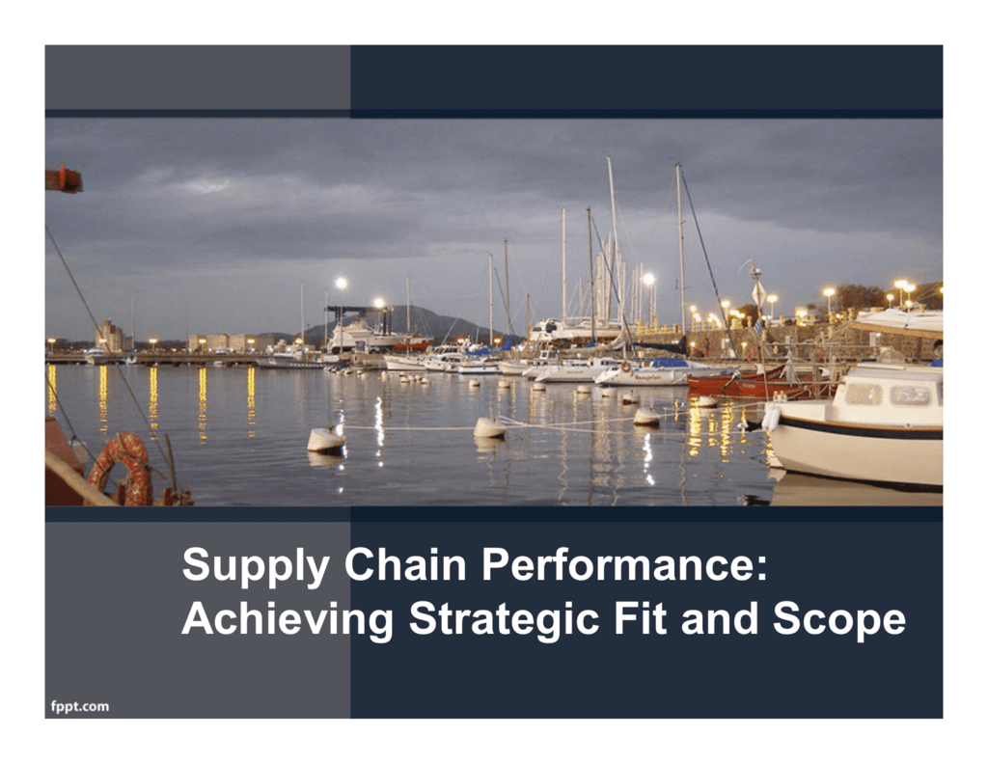
CH-5

Slide 2
Competitive and Supply Chain Strategies:
Competitive strategy define the set of customer needs a firm seeks to satisfy through its products and services
Product development strategies specifies the portfolio of new product that the company will try to develop
Marketing and sales strategy specifies how the market will be segmented and product positioned, priced and promoted.
Supply chain strategy determines the nature of material procurement, transportation of materials, manufacture of product or creation of service, distribution of product.

Slide 3
All functions strategies must support one another and the competitive strategy.
The Value Chain:

Slide 4
Achieving Strategic Fit:
Strategic Fit: Strategic fit refers to the alignment and coherence between an organizations strategy and its external environment, internal capabilities, and resources.
It’s the extent to which an organizations strategic choices and actions are consistent with overall objectives, market conditions and internal capabilities. Achieving strategic fit is crucial for an organizations success, as it ensures that its activities and resources are focused on delivering value to customer and achieving a sustainable competitive advantage.
.

Slide 5
competitive supply chain strategies have aligned goals
A company may fail because of a lack of strategic fit or because its processes and resources do not provide the capabilities to execute the desired strategy.
1. The competitive strategy and all functional strategies must fit together to form a coordinated overall strategy

Slide 6
2. The different functions in a company must appropriately structure their processes and resources to be able to execute these strategies successfully.
The design of the overall supply chain and the role of each stage must be aligned to support the supply chain strategy.

Slide 7
How is Strategic Fit Achieved?
Understanding the customer and supply chain uncertainty
Understanding the supply chain
Achieving strategic fit.

Slide 8
Understanding the customer and supply chain uncertainty:
Demand uncertainty: Uncertainty of customer demand for a product
Implied demand Uncertainty: resulting uncertainty for the supply chain given the portion of the demand the supply chain must handle and attributes the customer desires.

Slide 9
2. Understanding the customer:
lot size
Response time
Service level Implied Demand
Product variety Uncertain
Price
Innovation

Slide 10
Customer Needs and Implied Demand Uncertainty
Range of quantity required increases
Lead time decreases
Variety of products required increases
Number of channels through which product may be acquired increases
Rate of innovation increases
Required service level increases
Increase because a wider range of the quantity required implies greater variance in demand
Increase because there is less time in which to react to orders
Increase because demand per product becomes more disaggregate
Increase because the total customer
Increase because new products tend to have more uncertain demand
Increase because the firm now has to handle unusual surges in demand

Slide 11
Implied Uncertainty and Other Attributes
Products with uncertain demand are often less mature and have less direct competition. As a result, margins tend to be high.
Forecasting is more accurate when demand has less uncertainty.
Increased implied demand uncertainty leads to increased difficulty in matching supply with demand. For a given product, this dynamic can lead to either a stock out or an oversupply situation.
Markdowns are high for products with greater implied demand uncertainty because oversupply often results.

Slide 12
Step 2: Understanding Supply Chain Capabilities
How does the firm best meet demand?
Supply chain responsiveness is the ability to
–Respond to wide ranges of quantities demanded
–Meet short lead times
–Handle a large variety of products
–Build highly innovative products
–Meet a very high service level

Slide 13
Step 2: Understanding Supply Chain Capabilities
Responsiveness comes at a cost
•Supply chain efficiency is the inverse to the cost of making and delivering the product to the customer
•The cost-responsiveness efficient frontier curve shows the lowest possible cost for a given level of responsiveness

Slide 14
Step 3: Achieving Strategic Fit
Ensure that the degree of supply chain responsiveness is consistent with the implied uncertainty
Assign roles to different stages of the supply chain that ensure the appropriate level of responsiveness
Ensure that all functions maintain consistent strategies that support the competitive strategy

Slide 15
Zone of Strategic Fit

Slide 16
Zone of Strategic Fit

Slide 17
Obstacles to achieve strategic fit
Increasing variety of products

Decreasing product life cycles

Increasingly demanding customers

Fragmentation of supply chain ownership

Globalization

Difficulty executing new strategies
3-31
Obstacles to Achievingtrategic Fit
Increasing variety of products
Decreasing product life cycles
Increasingly demanding customers
Fragmentation of supply chain ownership
Globalization
Difficulty executing new strategies

Slide 18
Increasing variety of Products:
Customers demanding ever more customized products…………………….
2. Decreasing Product life cycles:
Today there are products whose life cycle can be measured in months, compared to the old standard of years,

Slide 19
3. Increasing demanding customers:
Customers are constantly demanding improvements in delivery lead times, cost and products performance.
4.Fragmentation of supply chain ownership:
Most firms have become less vertically integrated as companies have shed non core functions, they have been able to take advantage of suppliers and customers competencies that they themselves did not have.

Slide 20
5.Globalization :
Adds stress to chain, because facilities within the chain are farther apart, making coordination much more difficult.
6.Difficult in executing new strategies:
Once the good strategy is formulated, the execution of the strategy can be more difficult.
When obstacles arises, you change your direction to reach your goal; you don't change your decision to get there.

